Slide 1


Iot based electricity theft detection system
Final Review
GITAM (Deemed-to-be) University
Major Project
Project ID: PROJ3999
AY 2021-25
Department of Electrical Electronics and Communication Engineering
Project Team:
G. Rohith sai Devanga
M. Vamsi krishna
S. Bharat kumar
Project Mentor:
Dr. Jayatheerta
www.gitam.edu

Slide 2




Project Group – Details
Photo
Track
Roll No
Name
EECE AI/ML
BU21EECE0100199
G. Rohith Sai
EECE AI/ML
BU21EECE0100142
M Vamsi Krishna
EECE AI/ML
BU21EECE0100366
S Bharat Kumar

Slide 3
CONTENTS
Introduction
Abstract
Objective and Goals
Literature Survey
Block diagram of a project
Flow chart of project
Circuit diagram
List of components & specifications
Analysis of Component quality & cost management
Advantages & Disadvantages of project
Conclusion
Future Scope of the project
Reference

Slide 4
Introduction
Electricity theft is a very common problem, especially in our country. As our population is high so the use of electricity is tremendously high. There are many operational losses involve in the generation, transmission, and distribution of electrical energy. Whereas the losses implicated in generation can be technically defined, but transmission and distribution losses cannot be precisely quantified with the sending end information. In T&D the Technical losses are computed with the information about total load and the total energy bill. Electricity theft is a social evil, so it has to be eliminated completely. Power consumption and losses have to be closely monitored so that the generated power is utilized in a most efficient manner. The system prevents the illegal usage of electricity.

Slide 5
ABSTRACT
Science, and technology with its miraculous advancements fascinated human life to an honest extent that will imagine a world without these innovations is hardly possible. While technology is on the raising slope, we should always also note increasing immoral activities. With a technical view, "Power Theft" is also a non-ignorable crime that's highly prevalent, and at the same time, it directly affects the economy of a nation. Detecting and eradicating such crimes with the help of the developing scientific field is that the "Need of the Hour". With these views the was paper conceived and designed. Our paper provides an entire and comprehensive tool to stop power theft which is extremely simple to understand and easy to implement. It includes some sections-transmitting, receiving, and processing sections. The most objective of this project is to point power theft to the electricity board. It's carried over through embedded technology. Here a wireless method is utilized to hunt out electrical theft.

Slide 6
Objective and Goals
Objective
To develop an efficient and reliable system for detecting power theft, minimizing financial losses for utility companies, and ensuring fair electricity distribution.
Goals
Identify and monitor irregularities in electricity consumption patterns.
Implement real-time power theft detection using advanced technologies like IoT and machine learning.
Reduce energy losses by accurately pinpointing theft locations.
Improve the accuracy of energy billing for consumers and utilities.
Enhance overall system security to prevent future power theft attempts

Slide 7
Literature Survey
Author(s) | Year | Methodology/Technique | Key Findings | Limitations
Smith et al. | 2019 | Machine Learning (ANN) | Accurate detection of abnormal consumption patterns | High computational cost
Johnson & Lee | 2020 | IoT-based Monitoring System | Real-time theft detection | Requires significant infrastructure investment
Kumar et al. | 2021 | Smart Meters with Data Analytics | Improved billing accuracy and theft prevention | Susceptible to cyber attacks
Patel & Singh | 2022 | Hybrid AI (ML + Blockchain) | Enhanced security and transparency in energy systems | Complexity in implementation and maintenance
Zhang et al. | 2023 | Deep Learning Algorithms | High accuracy in predicting theft locations | Limited testing in diverse environments

Slide 8
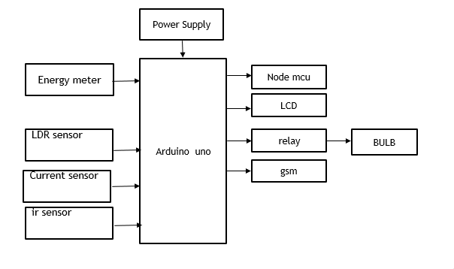
BLOCK DIAGRAM

Slide 9
Existing Method
Before the implementation of IoT-based systems for electricity theft detection, manual inspection was the primary method for identifying unauthorized power consumption. This traditional approach involved periodic physical checks by utility workers who would inspect energy meters and wiring for signs of tampering or irregularities. In cases of suspected theft, the utility personnel would manually read the meter, compare it to expected usage patterns, and investigate any discrepancies. However, this method was time-consuming, labor-intensive, and often reactive rather than proactive, leading to delays in detecting theft and potential losses for utility companies

Slide 10
List of components & specifications
Hardware Requirement
Arduino
Lcd
Energy meter
Ldr sensor
Relay
Bulb Holder-2
Bulb 200w,60w
Current sensor
Gsm
Nodemcu
Power supply
Adapter 12v
Power cable
Ir sensor
Software Requirement
Arduino IDE
Embedded C

Slide 11
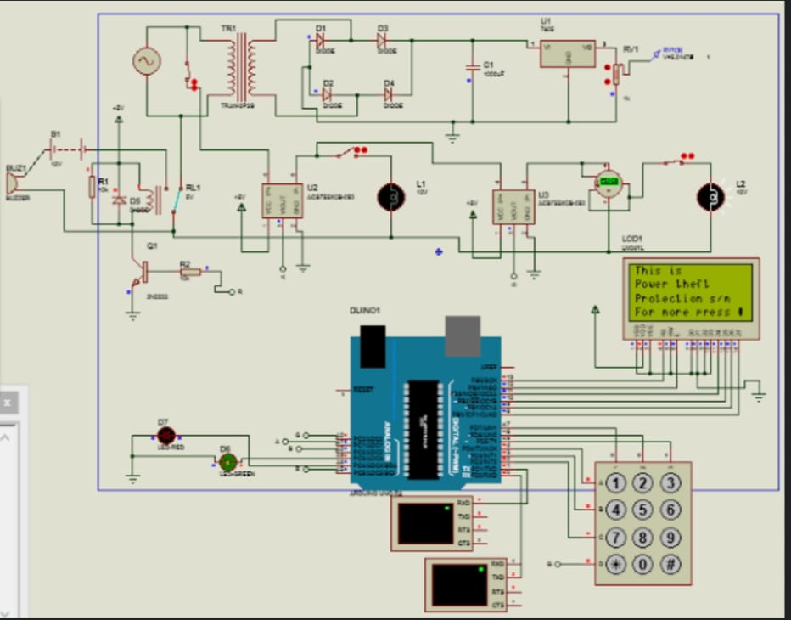
Circuit Diagram

Slide 12
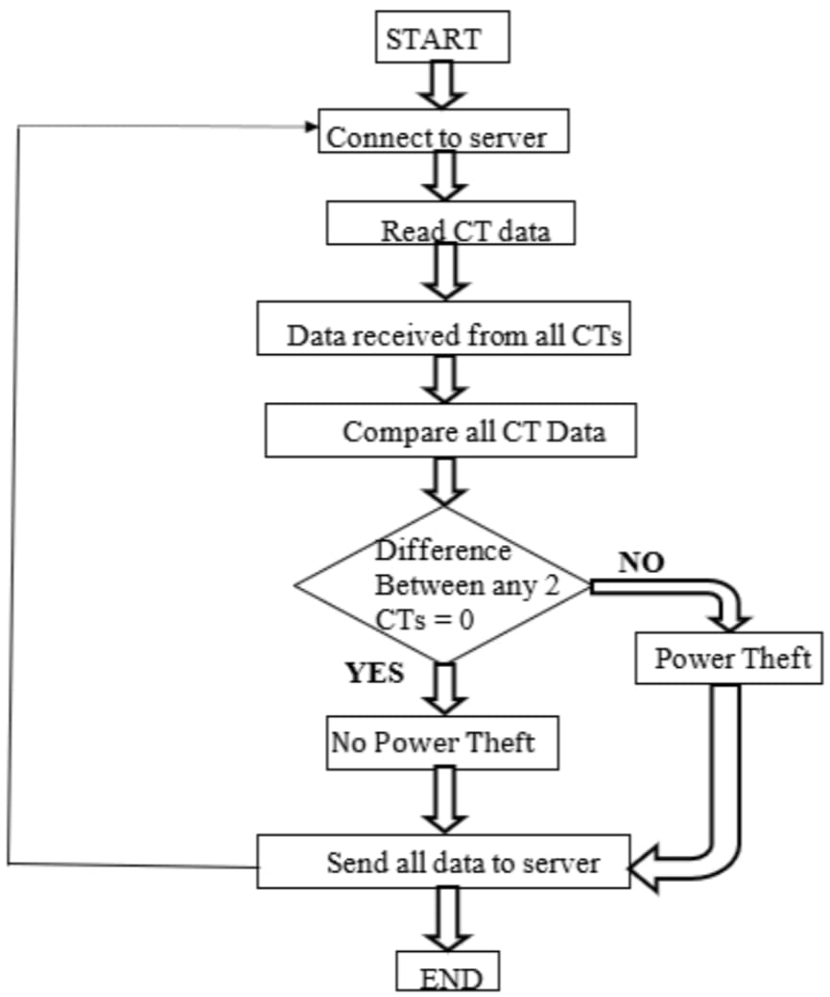
Flow Chart

Slide 13
Proposed method
The proposed IoT-based electricity theft detection system offers a proactive solution to monitor and control electricity consumption in real-time. By utilizing an Arduino microcontroller to interface with an energy meter, current sensor, LDR sensor, relay, GSM module, and NodeMCU, the system continuously tracks power usage and identifies abnormal consumption patterns. When an increase in current usage is detected, the system sends an alert via GSM to the user and uploads the data to the ThingSpeak server for remote monitoring. The LCD displays key data locally for immediate access. The relay automatically turns the load on or off depending on the consumption condition, preventing unauthorized usage. This method enables continuous, automated monitoring and immediate action, significantly improving the efficiency of electricity management and theft detection.

Slide 14
Applications
Residential Electricity Theft Detection
Industrial Power Consumption Monitoring
Utility Companies for Theft Prevention
Smart Grid Integration
Energy Management in Commercial Buildings

Slide 15
Conclusion
In conclusion, the IoT-based electricity theft detection system provides an effective and efficient solution for monitoring and managing electricity consumption. By leveraging the Arduino microcontroller, the system integrates various components such as the energy meter, current sensor, GSM module, NodeMCU, and relay to detect abnormal usage patterns indicative of theft. The real-time data transmission to the ThingSpeak server ensures remote monitoring, while local data display on the LCD allows immediate feedback. The relay further enhances security by controlling the load to prevent unauthorized use. This system not only helps in detecting and preventing electricity theft but also promotes efficient energy management, contributing to reduced energy losses and improved utility monitoring.

Slide 16
References
A. Gupta, V. Gupta, and M. Bansal, "An IoT-based Electricity Theft Detection and Prevention System," International Journal of Advanced Research in Computer Science and Engineering, vol. 6, no. 7, pp. 110-115, 2018.
S. S. Kulkarni, S. M. Pawar, and S. V. Jadhav, "Design and Implementation of Smart Energy Meter for IoT-based Monitoring," International Journal of Electronics and Communication Engineering & Technology, vol. 9, no. 4, pp. 1225-1231, 2018.
R. Patel, V. J. Patel, and S. P. Patel, "IoT-based Smart Energy Meter for Electricity Theft Detection and Prevention," International Journal of Advanced Research in Electrical, Electronics and Instrumentation Engineering, vol. 6, no. 3, pp. 1887-1893, 2017.
P. M. S. P. Pradeep, and M. R. Manju, "Implementation of Smart Meter for Electricity Theft Detection Using IoT Technology," International Journal of Emerging Trends in Engineering Research, vol. 7, no. 6, pp. 372-376, 2019.

Slide 17

THANK YOU

